Slide 1
Lecture 1: Likelihoods and linear models
March 27, 2024

Slide 2
[Classroom introductions]

Slide 3
[Go through syllabus]

Slide 4
How do we estimate things?
Specify a model
Function generating predictions
Identify plausible values for any unknown parameters
Maximize probability of observations given function
Assess uncertainty
Explore function around plausible values

Slide 5
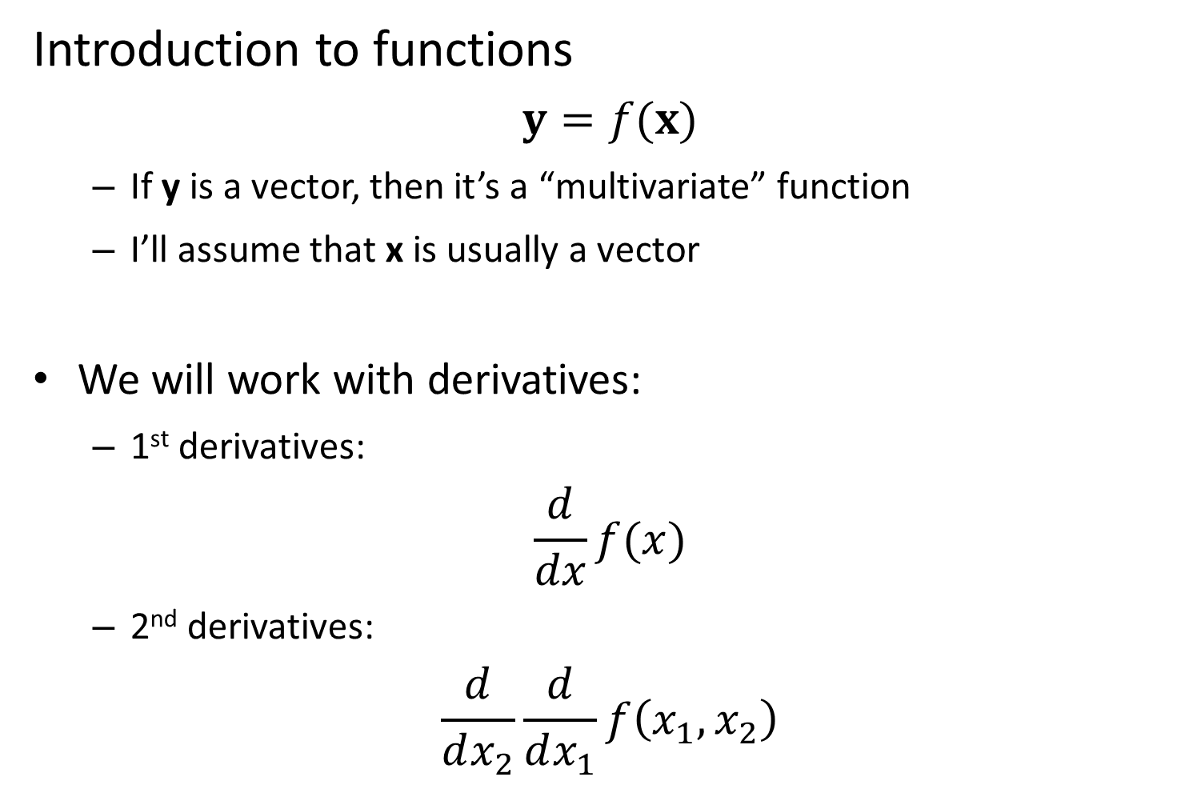
Introduction to functions
$$y=f(x)$$
If y is a vector, then it’s a “multivariate” function
I’ll assume that x is usually a vector
We will work with derivatives:
1st derivatives:
$$\frac{d}{dx}f(x)$$
2nd derivatives:
$$\frac{d}{dx_{2}}\frac{d}{dx_{1}}f\left(x_{1},x_{2}\right)$$

Slide 6
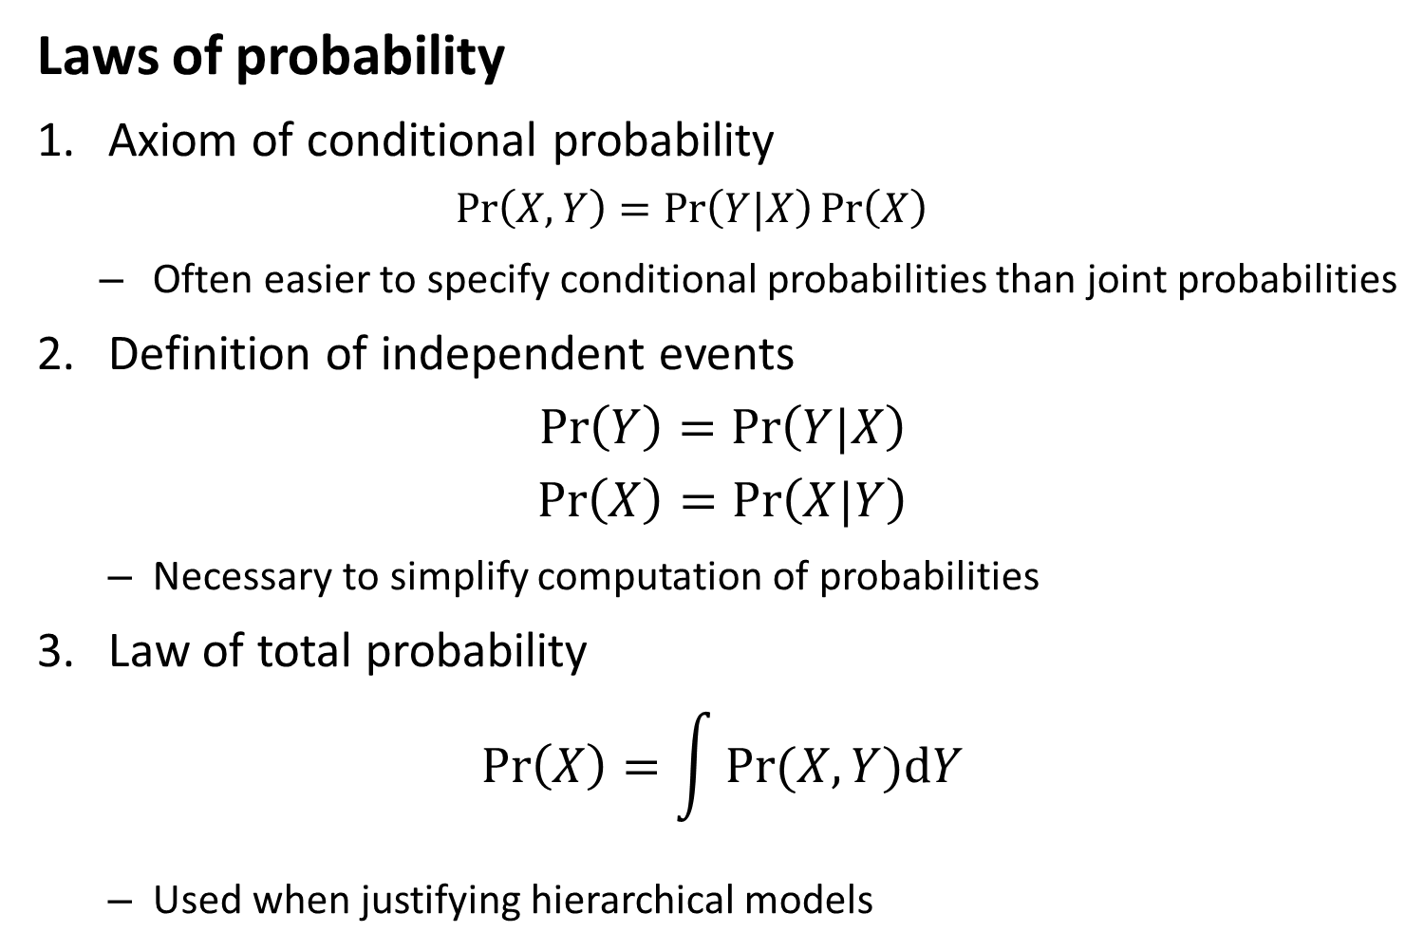
Laws of probability
1. Axiom of conditional probability
$$\operatorname{Pr}\left(X,Y\right)=\operatorname{Pr}\left(Y|X\right)\operatorname{Pr}\left(X\right)$$
Often easier to specify conditional probabilities than joint probabilities
2. Definition of independent events
$$\operatorname{Pr}\left(Y\right)=\operatorname{Pr}\left(Y|X\right)$$
$$\operatorname{Pr}\left(X\right)=\operatorname{Pr}\left(X|Y\right)$$
Necessary to simplify computation of probabilities
3. Law of total probability
$$\operatorname{Pr}\left(X\right)=\int{Pr⁡(X,Y)dY}$$
Used when justifying hierarchical models

Slide 7
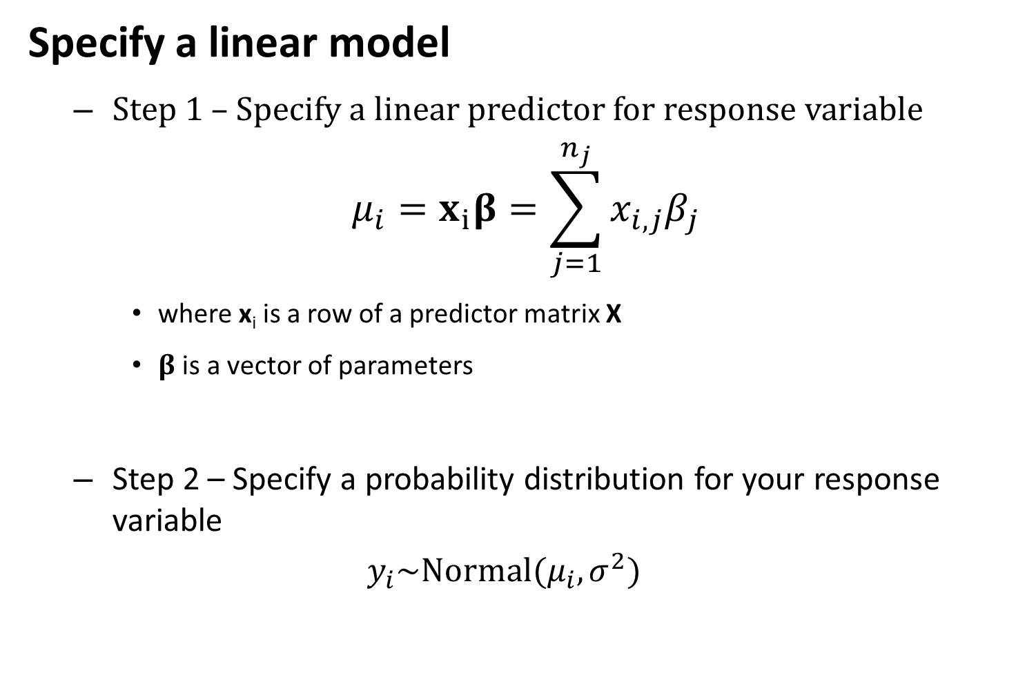
Specify a linear model
Step 1 – Specify a linear predictor for response variable
$$μ_{i}=x_{i}β=\sum_{j=1}^{n_{j}}{x_{i,j}β_{j}}$$
where x_{i} is a row of a predictor matrix X
$β$ is a vector of parameters
Step 2 – Specify a probability distribution for your response variable
$$y_{i}\sim Normal(μ_{i},σ^{2})$$

Slide 8

Maximum likelihood estimation (MLE)
$$\hat{θ}=argmax_{θ}\left(L(θ;y)\right)$$
Where $\hat{θ}$ is the MLE estimate of parameters
Where$argmax_{θ}\left(L(θ;y)\right)$is the maximum value for $L(θ;y)$that can be achieved for any value of $θ$
argmax is done using maximization algorithms

Slide 9
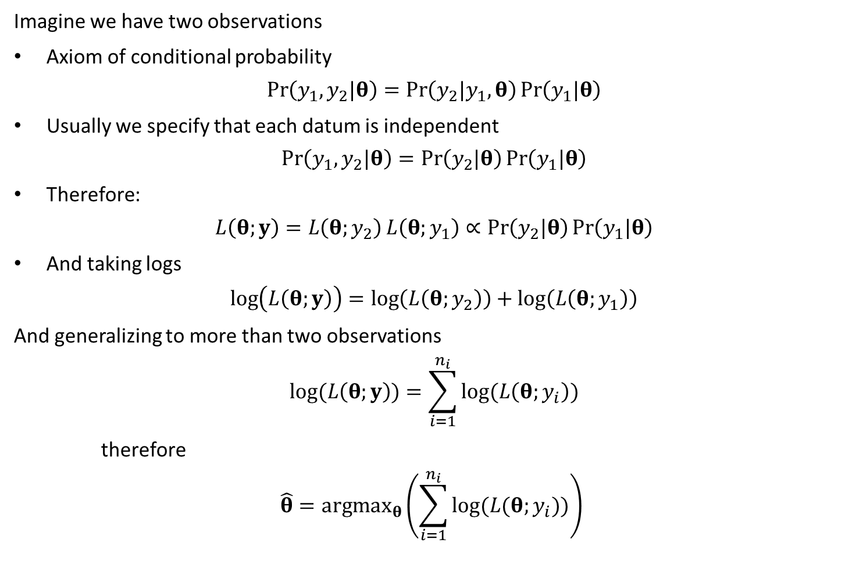
Imagine we have two observations
Axiom of conditional probability
$$\operatorname{Pr}\left(y_{1},y_{2}|θ\right)=\operatorname{Pr}\left(y_{2}|y_{1},θ\right)\operatorname{Pr}\left(y_{1}|θ\right)$$
Usually we specify that each datum is independent
$$\operatorname{Pr}\left(y_{1},y_{2}|θ\right)=\operatorname{Pr}\left(y_{2}|θ\right)\operatorname{Pr}\left(y_{1}|θ\right)$$
Therefore:
$$L\left(θ;y\right)=L\left(θ;y_{2}\right)L\left(θ;y_{1}\right)∝\operatorname{Pr}\left(y_{2}|θ\right)\operatorname{Pr}\left(y_{1}|θ\right)$$
And taking logs
$$\log\left(L\left(θ;y\right)\right)=\log\left(L\left(θ;y_{2}\right)\right)+\log\left(L\left(θ;y_{1}\right)\right)$$
And generalizing to more than two observations
$$log⁡(L\left(θ;y\right))=\sum_{i=1}^{n_{i}}{log⁡(L\left(θ;y_{i}\right))}$$
therefore
$$\hat{θ}=argmax_{θ}\left(\sum_{i=1}^{n_{i}}{log⁡(L(θ;y_{i}))}\right)$$

Slide 10
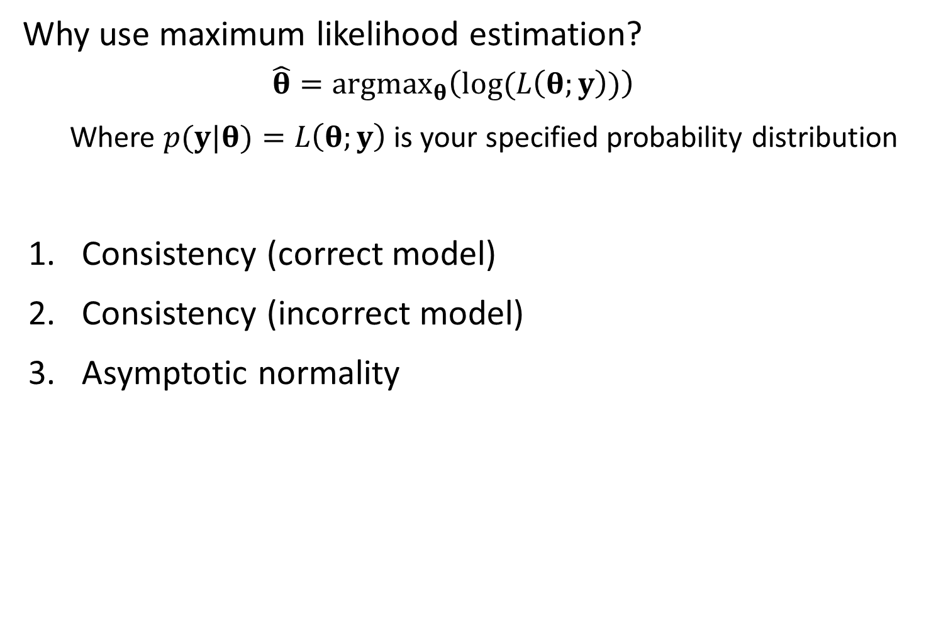
Why use maximum likelihood estimation?
$$\hat{θ}=argmax_{θ}\left(log⁡(L\left(θ;y\right))\right)$$
Where $p(y|θ)=L\left(θ;y\right)$ is your specified probability distribution
Consistency (correct model)
Consistency (incorrect model)
Asymptotic normality

Slide 11
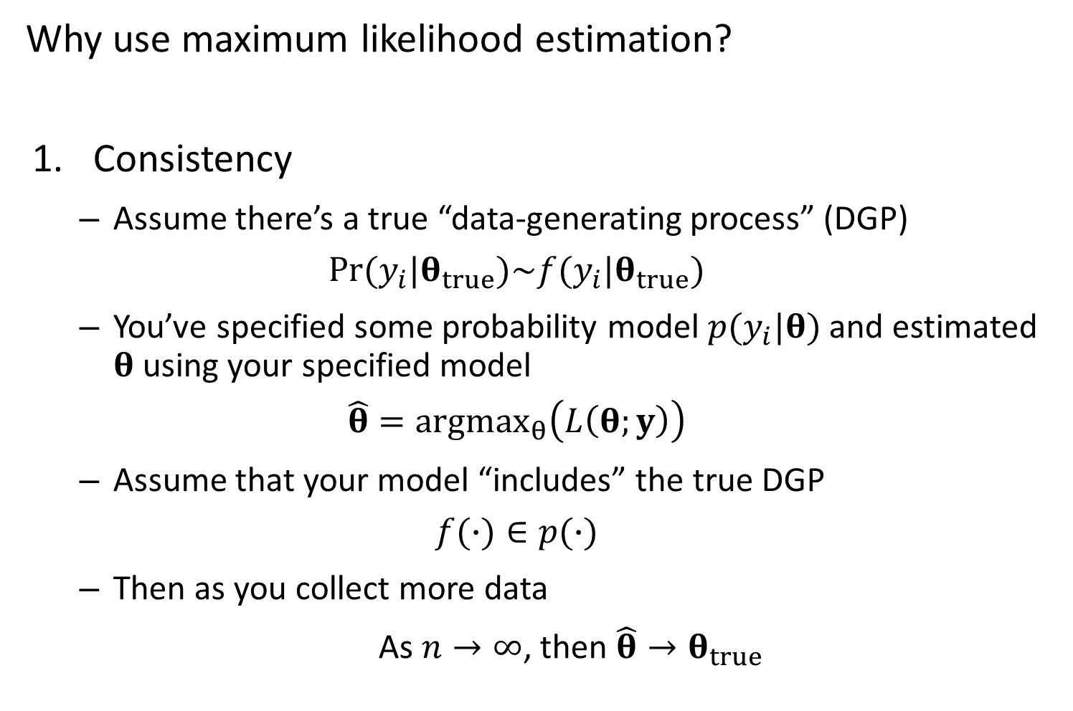
Why use maximum likelihood estimation?
Consistency
Assume there’s a true “data-generating process” (DGP)
$$Pr⁡(y_{i}|θ_{true})\sim f(y_{i}|θ_{true})$$
You’ve specified some probability model $p(y_{i}|θ)$ and estimated $θ$ using your specified model
$$\hat{θ}={argmax}_{θ}\left(L\left(θ;y\right)\right)$$
Assume that your model “includes” the true DGP
$$f(∙)∈p(∙)$$
Then as you collect more data
As $n→∞$, then $\hat{θ}→θ_{true}$

Slide 12
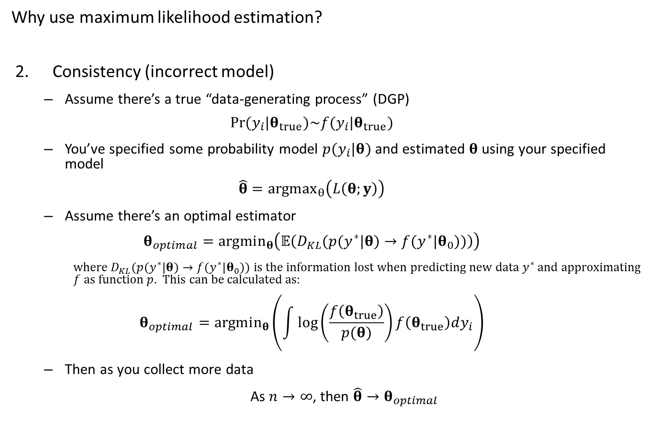
Why use maximum likelihood estimation?
Consistency (incorrect model)
Assume there’s a true “data-generating process” (DGP)
$$Pr⁡(y_{i}|θ_{true})\sim f(y_{i}|θ_{true})$$
You’ve specified some probability model $p(y_{i}|θ)$ and estimated $θ$ using your specified model
$$\hat{θ}={argmax}_{θ}\left(L\left(θ;y\right)\right)$$
Assume there’s an optimal estimator
$$θ_{optimal}=argmin_{θ}\left(𝔼\left(D_{KL}(p(y^{∗}|θ)→f(y^{∗}|θ_{0}))\right)\right)$$
where $D_{KL}(p(y^{∗}|θ)→f(y^{∗}|θ_{0}))$ is the information lost when predicting new data $y^{∗}$ and approximating $f$ as function $p$. This can be calculated as:
$$θ_{optimal}=argmin_{θ}\left(\int{\log\left(\frac{f\left(θ_{true}\right)}{p(θ)}\right)f\left(θ_{true}\right)dy_{i}}\right)$$
Then as you collect more data
As $n→∞$, then $\hat{θ}→θ_{optimal}$

Slide 13
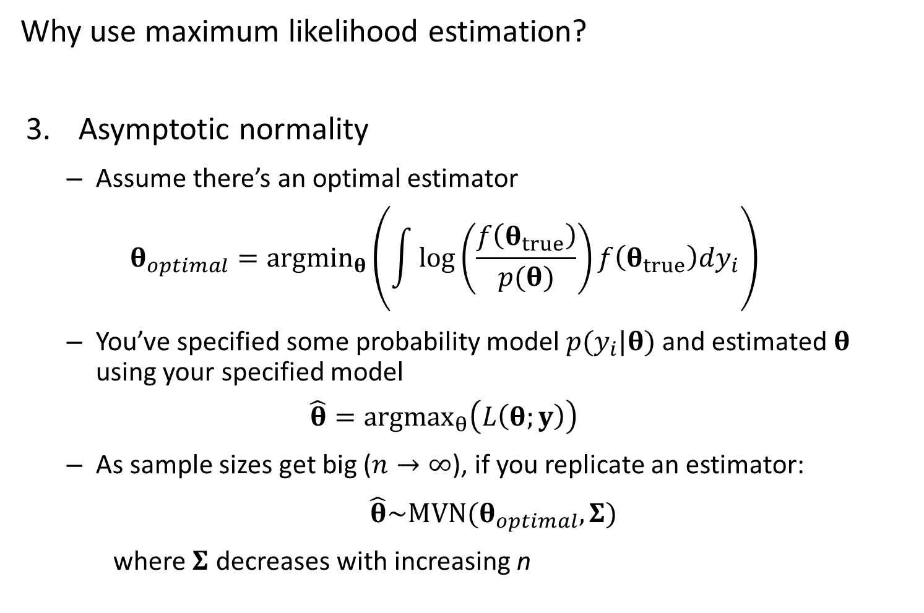
Why use maximum likelihood estimation?
Asymptotic normality
Assume there’s an optimal estimator
$$θ_{optimal}=argmin_{θ}\left(\int{\log\left(\frac{f\left(θ_{true}\right)}{p(θ)}\right)f\left(θ_{true}\right)dy_{i}}\right)$$
You’ve specified some probability model $p(y_{i}|θ)$ and estimated $θ$ using your specified model
$$\hat{θ}={argmax}_{θ}\left(L\left(θ;y\right)\right)$$
As sample sizes get big ($n→∞$), if you replicate an estimator:
$\hat{θ}\sim MVN(θ_{optimal},Σ)$
where $Σ$ decreases with increasing n

Slide 14
Implications
If you have a simulation design…
… and the model used to simulate data is identical to the model used to estimate parameters
Estimated parameters will be perfect with large sample sizes
Total error will go to zero with large sample sizes
… and your estimation model doesn’t match the simulation model
Estimated parameters will converge on values with large sample sizes
Total error will decrease to an asymptote

Slide 15
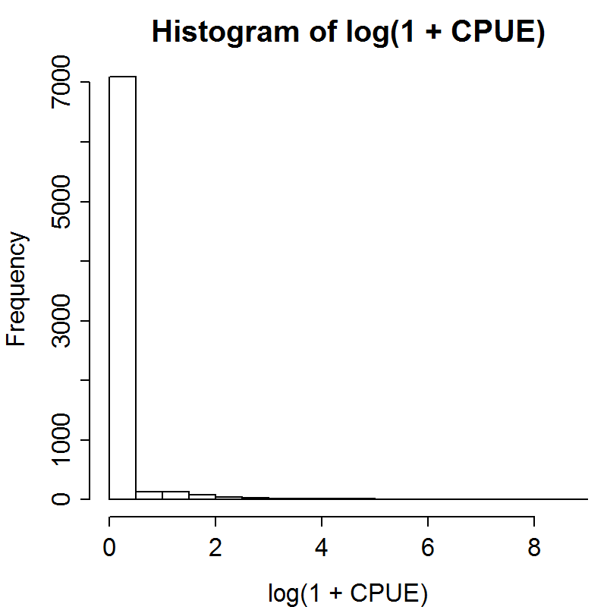
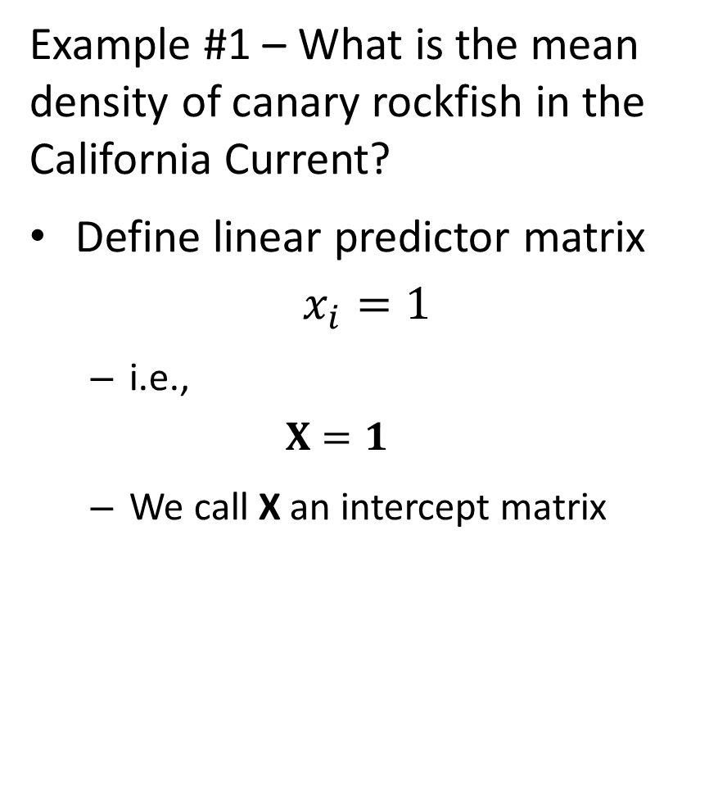
Example #1 – What is the mean density of canary rockfish in the California Current?
Define linear predictor matrix
$$x_{i}=1$$
i.e.,
$$X=1$$
We call X an intercept matrix

Slide 16
Approach 1 – Use existing R functions
Step 1 – Find function
For linear model, use lm in the base package
Step 2 – Apply function
Usually easy in R
Step 3 – Extract information from object
Often hard
Sometimes use summary or attributes commands

Slide 17
Approach 1
[See R code]

Slide 18
Approach 2 – Build your own code
Step 1 – make function for log-likelihood
Step 2 – use nonlinear minimizer to find maximum likelihood estimate
Step 3 – estimate standard errors

Slide 19
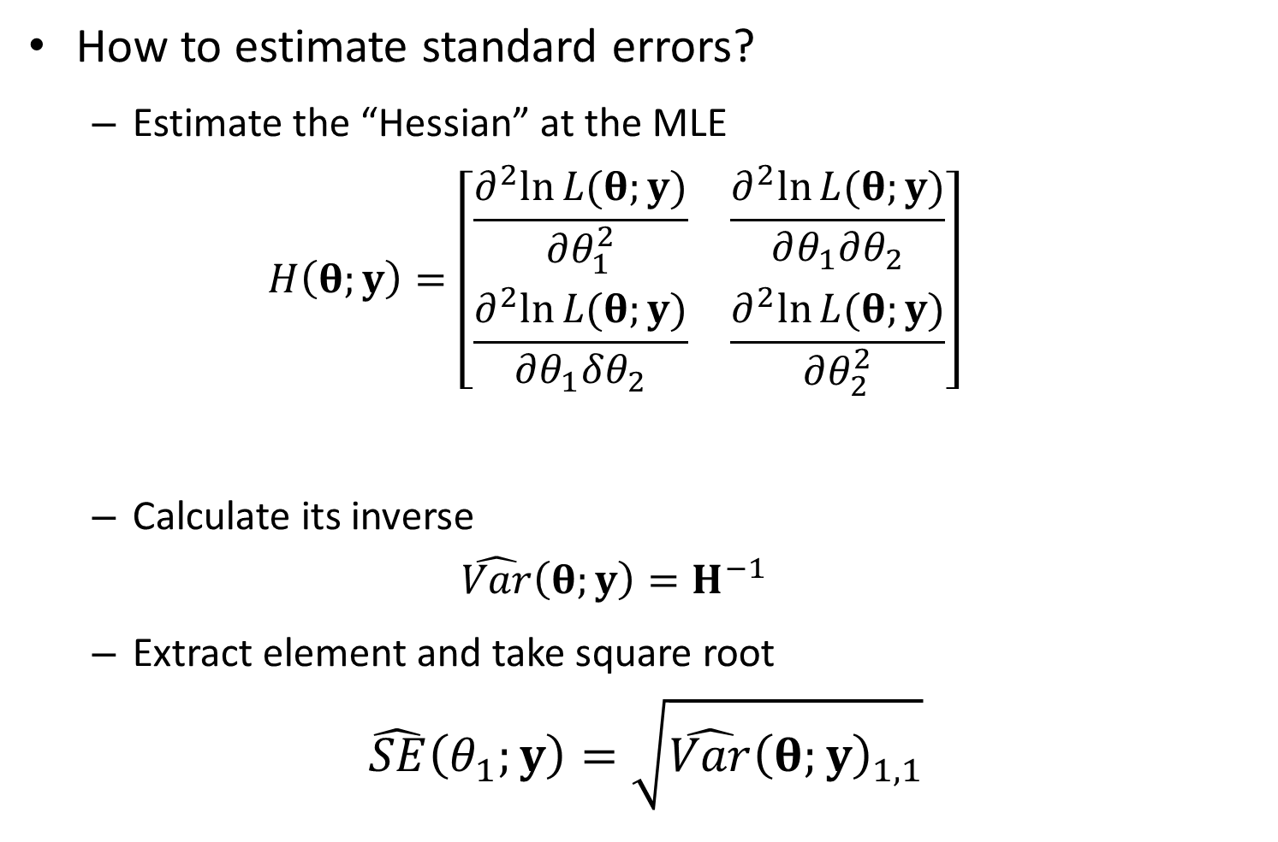
How to estimate standard errors?
Estimate the “Hessian” at the MLE
$$H\left(θ;y\right)=\left[\begin{matrix}\frac{∂^{2}ln⁡L(θ;y)}{∂θ_{1}^{2}} & \frac{∂^{2}ln⁡L(θ;y)}{∂θ_{1}∂θ_{2}} \\ \frac{∂^{2}ln⁡L(θ;y)}{∂θ_{1}δθ_{2}} & \frac{∂^{2}ln⁡L(θ;y)}{∂θ_{2}^{2}}\end{matrix}\right]$$
Calculate its inverse
$$\hat{Var}\left(θ;y\right)=H^{−1}$$
Extract element and take square root
$$\hat{SE}\left(θ_{1};y\right)=\sqrt{\hat{Var}{\left(θ;y\right)}_{1,1}}$$

Slide 20
Approach 2
[See R code]

Slide 21
Approach 3 – Use TMB
Step 1 – Define TMB template file
Uses C++ code
Step 2 – Define inputs for TMB
List of “tagged” (named) elements for data and starting paramesters
Step 3 – Run optimizer in R
Nonlinear optimizers using gradients
Step 4 – Check model diagnostics

Slide 22
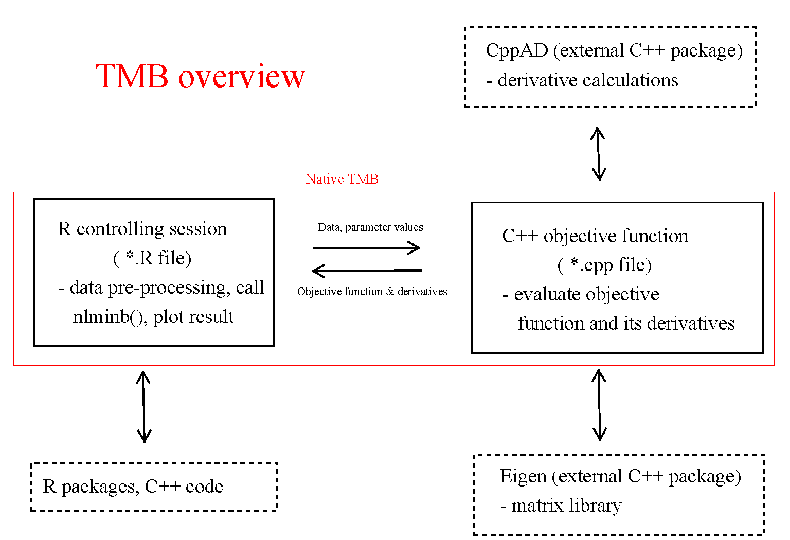

Slide 23
Approach 3
[See R code]

Slide 24
How to know you understand a model?
Make predictions about behavior, and double check predictions
Simulation experiments
Next step:
Add covariates (pass and latitude)
Prediction: Adding fixed effects will always decrease the residual variance in a linear model

Slide 25
Testing prediction: effect of adding linear predictors
[See R code]
Was the prediction supported?

Slide 26
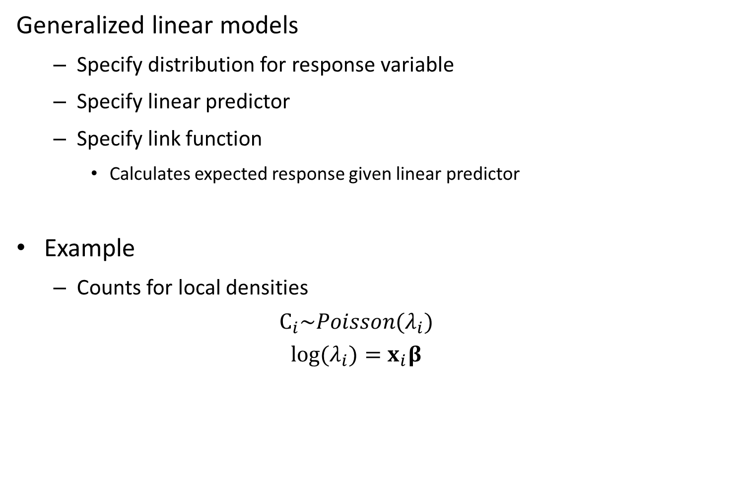
Generalized linear models
Specify distribution for response variable
Specify linear predictor
Specify link function
Calculates expected response given linear predictor
Example
Counts for local densities
$$C_{i}\sim Poisson(λ_{i})$$
$$log⁡(λ_{i})=x_{i}β$$

Slide 27
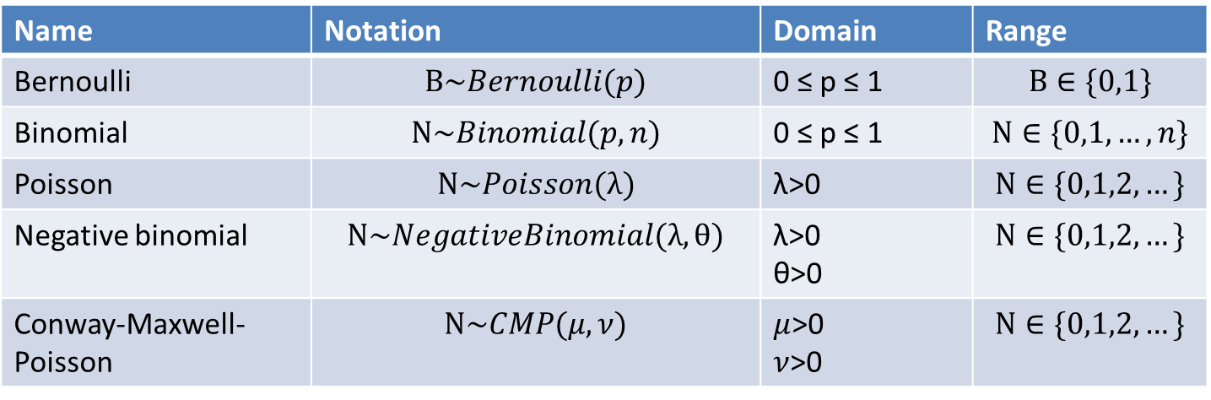
Common distributions for data
Discrete
Name | Notation | Domain | Range
Bernoulli | $$B\sim Bernoulli(p)$$ | 0 ≤ p ≤ 1 | $$B∈\{0,1\}$$
Binomial | $$N\sim Binomial(p,n)$$ | 0 ≤ p ≤ 1 | $$N∈\{0,1,…,n\}$$
Poisson | $$N\sim Poisson(λ)$$ | λ>0 | $$N∈\{0,1,2,…\}$$
Negative binomial | $$N\sim NegativeBinomial(λ,θ)$$ | λ>0 θ>0 | $$N∈\{0,1,2,…\}$$
Conway-Maxwell-Poisson | $$N\sim CMP(μ,ν)$$ | $μ$>0 $ν$>0 | $$N∈\{0,1,2,…\}$$

Slide 28
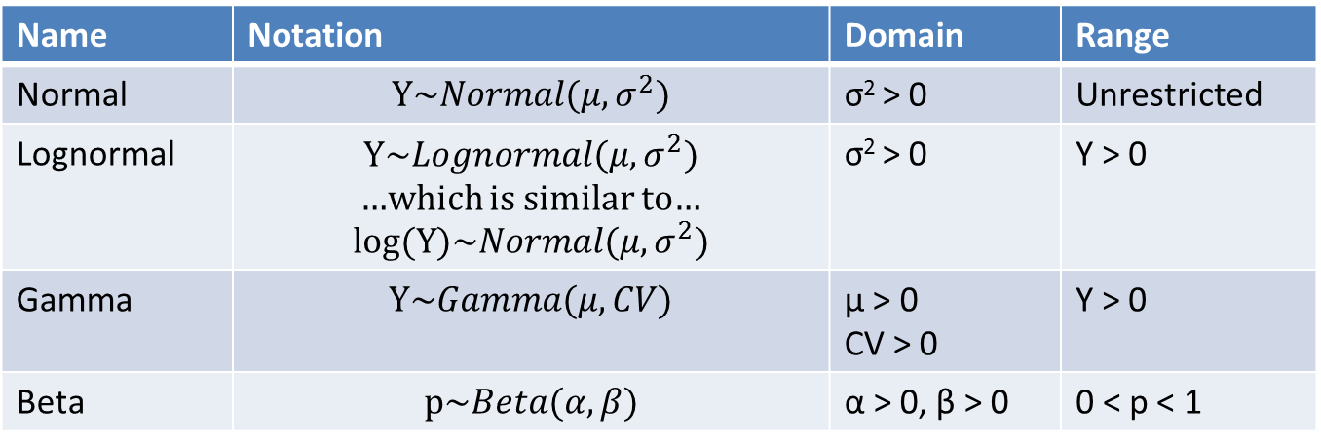
Common distributions for data
Continuous
Name | Notation | Domain | Range
Normal | $$Y\sim Normal(μ,σ^{2})$$ | σ² > 0 | Unrestricted
Lognormal | $$Y\sim Lognormal(μ,σ^{2})$$ …which is similar to… $$log⁡(Y)\sim Normal(μ,σ^{2})$$ | σ² > 0 | Y > 0
Gamma | $$Y\sim Gamma(μ,CV)$$ | μ > 0 CV > 0 | Y > 0
Beta | $$p\sim Beta(α,β)$$ | α > 0, β > 0 | 0 < p < 1

Slide 29
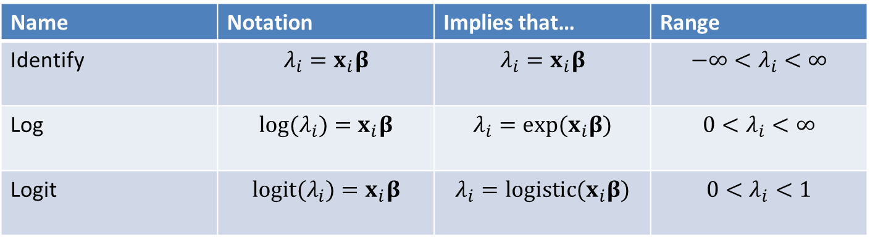
Common link functions
Name | Notation | Implies that… | Range
Identify | $$λ_{i}=x_{i}β$$ | $$λ_{i}=x_{i}β$$ | $$−∞<λ_{i}<∞$$
Log | $$log⁡(λ_{i})=x_{i}β$$ | $$λ_{i}=exp⁡(x_{i}β)$$ | $$0<λ_{i}<∞$$
Logit | $$logit⁡(λ_{i})=x_{i}β$$ | $$λ_{i}=logistic(x_{i}β)$$ | $$0<λ_{i}<1$$

Slide 30
How to chose a distribution for data?
Choice 1 – is it continuous or discrete?
Continuous: normal, lognormal, beta, gamma
Discrete: Bernoulli, binomial, poisson, negative binomial
Choice 2 – what is the range of possible values?
E.g., if discrete:
If is is 0 or 1, then its Bernoulli
If its between 0 and N, where N is the number of trials, then its Binomial
Choice 3 – How flexible do you want it?

Slide 31
How to chose a distribution for data?
Frequent null models:
Binomial
Poisson
Normal

Slide 32
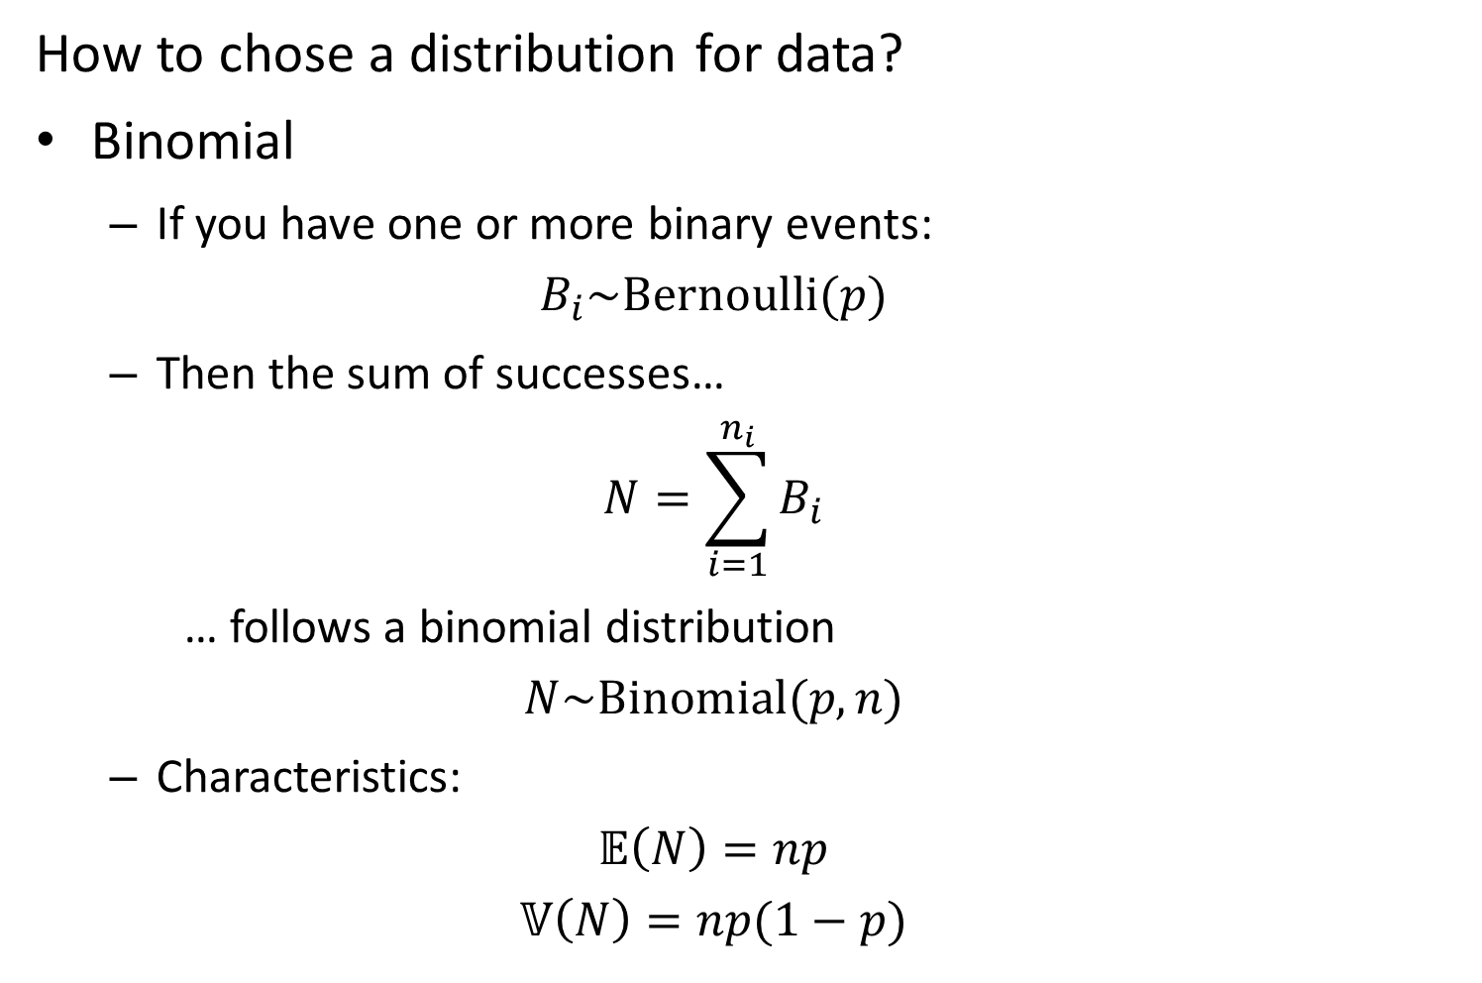
How to chose a distribution for data?
Binomial
If you have one or more binary events:
$$B_{i}\sim Bernoulli(p)$$
Then the sum of successes…
$$N=\sum_{i=1}^{n_{i}}{B_{i}}$$
… follows a binomial distribution
$$N\sim Binomial(p,n)$$
Characteristics:
$$𝔼\left(N\right)=np$$
$$𝕍\left(N\right)=np(1−p)$$

Slide 33
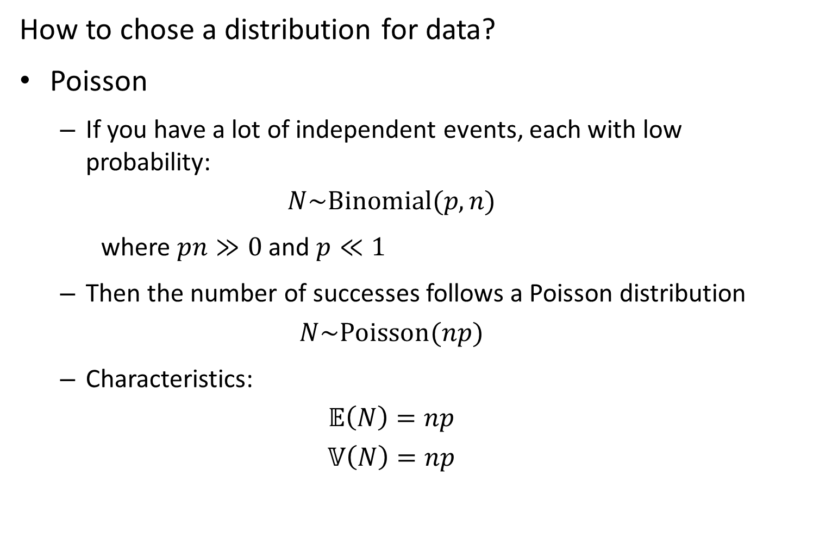
How to chose a distribution for data?
Poisson
If you have a lot of independent events, each with low probability:
$$N\sim Binomial(p,n)$$
where $pn≫0$ and $p≪1$
Then the number of successes follows a Poisson distribution
$$N\sim Poisson(np)$$
Characteristics:
$$𝔼\left(N\right)=np$$
$$𝕍\left(N\right)=np$$

Slide 34
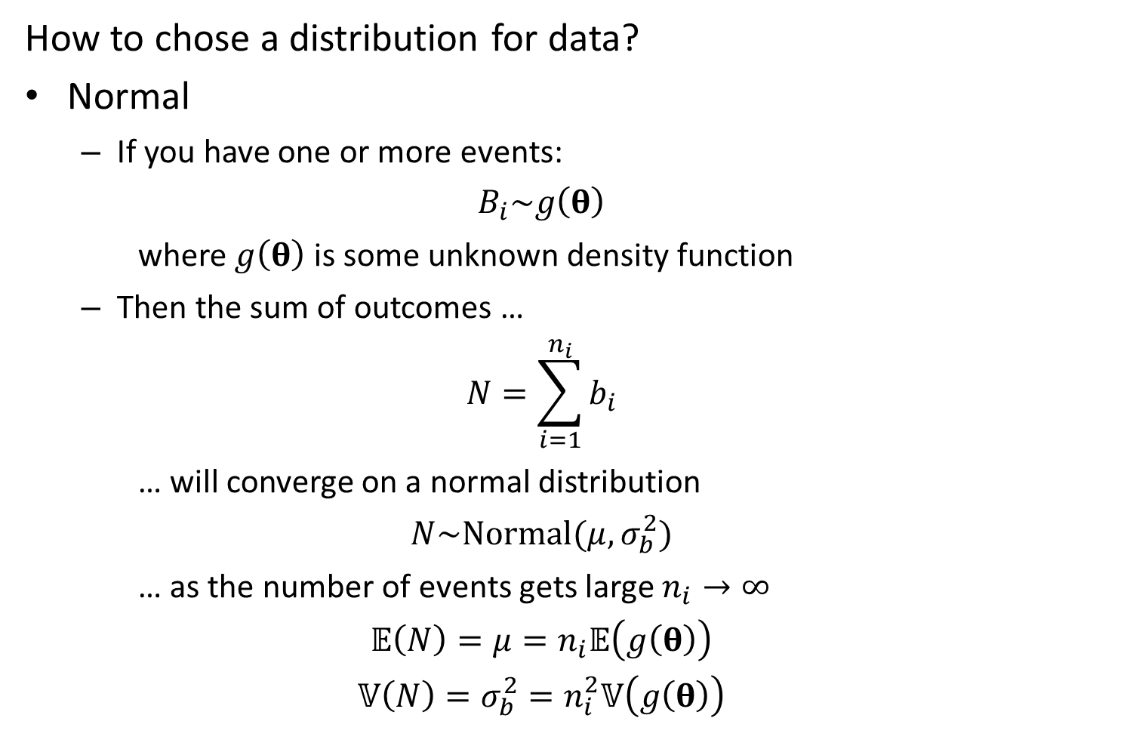
How to chose a distribution for data?
Normal
If you have one or more events:
$$B_{i}\sim g\left(θ\right)$$
where $g\left(θ\right)$ is some unknown density function
Then the sum of outcomes …
$$N=\sum_{i=1}^{n_{i}}{b_{i}}$$
… will converge on a normal distribution
$$N\sim Normal(μ,σ_{b}^{2})$$
… as the number of events gets large $n_{i}→∞$
$$𝔼\left(N\right)=μ=n_{i}𝔼\left(g\left(θ\right)\right)$$
$$𝕍\left(N\right)=σ_{b}^{2}=n_{i}^{2}𝕍\left(g\left(θ\right)\right)$$

Slide 35
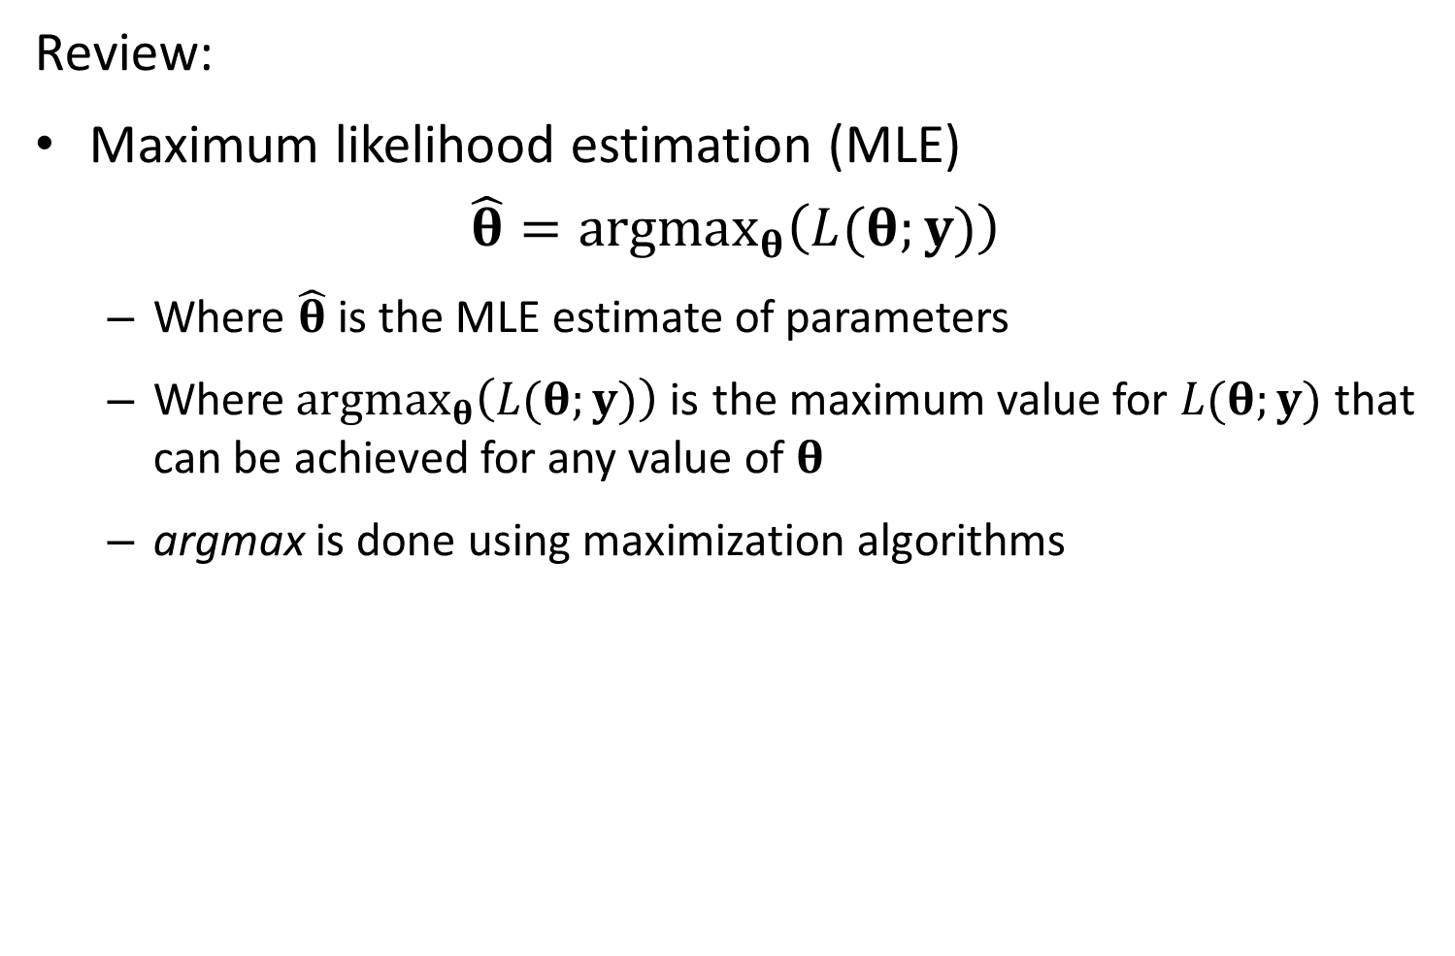
Review:
Maximum likelihood estimation (MLE)
$$\hat{θ}=argmax_{θ}\left(L(θ;y)\right)$$
Where $\hat{θ}$ is the MLE estimate of parameters
Where$argmax_{θ}\left(L(θ;y)\right)$is the maximum value for $L(θ;y)$that can be achieved for any value of $θ$
argmax is done using maximization algorithms

Slide 36
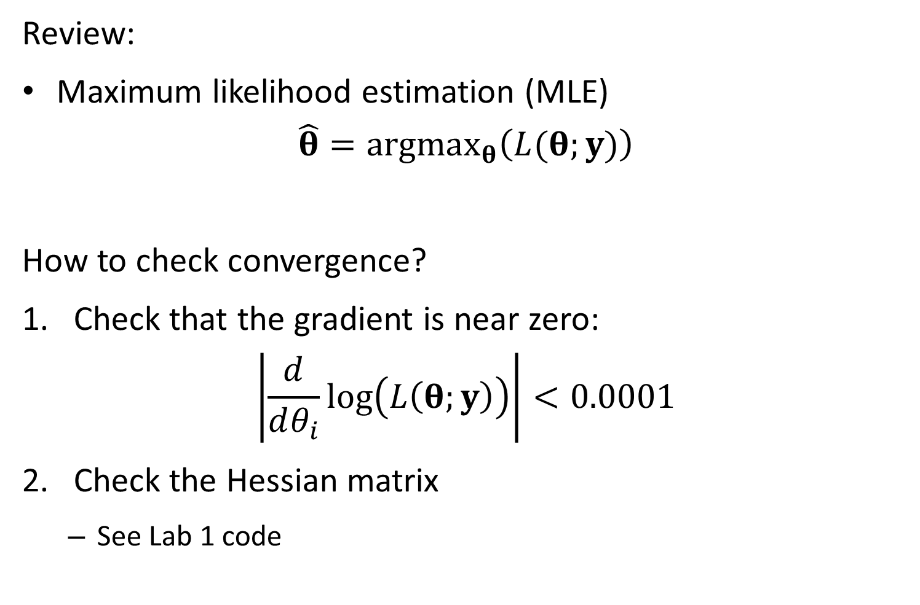
Review:
Maximum likelihood estimation (MLE)
$$\hat{θ}=argmax_{θ}\left(L(θ;y)\right)$$
How to check convergence?
Check that the gradient is near zero:
$$\left|\frac{d}{dθ_{i}}\log\left(L\left(θ;y\right)\right)\right|<0.0001$$
Check the Hessian matrix
See Lab 1 code

Slide 37
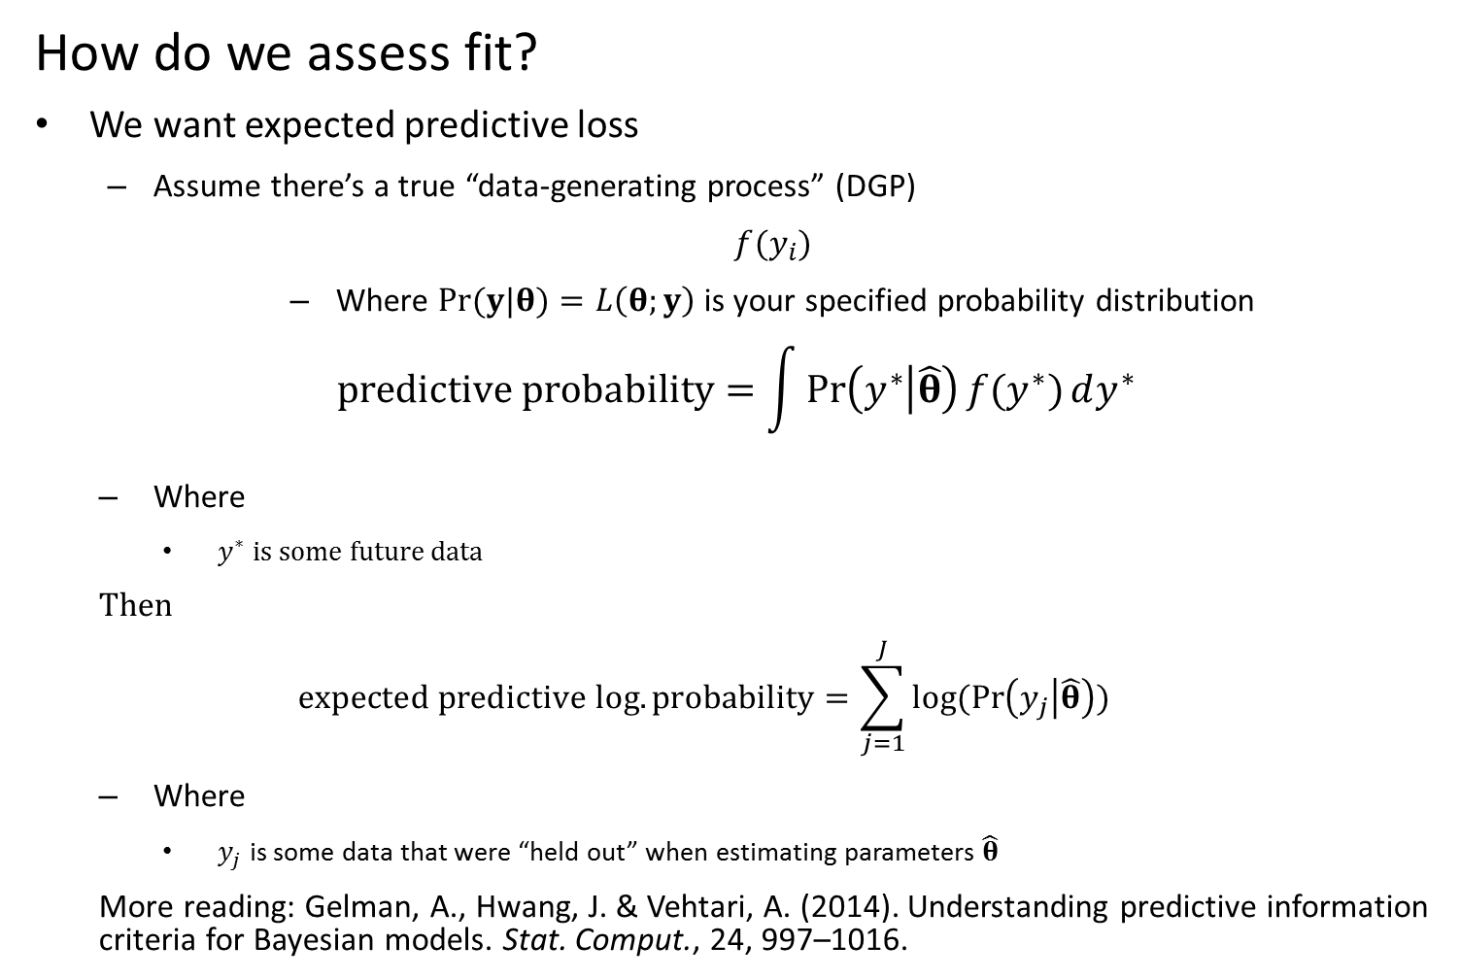
How do we assess fit?
We want expected predictive loss
Assume there’s a true “data-generating process” (DGP)
$f(y_{i})$
Where $Pr(y|θ)=L\left(θ;y\right)$ is your specified probability distribution
$$predictive probability=\int{Pr\left(y^{∗} | \hat{θ}\right){f(y^{∗})}dy^{∗}}$$
Where
$y^{∗}$ is some future data
Then
$$expected predictive log.probability=\sum_{j=1}^{J}{log⁡(Pr\left(y_{j} | \hat{θ}\right))}$$
Where
$y_{j}$ is some data that were “held out” when estimating parameters $\hat{θ}$
More reading: Gelman, A., Hwang, J. & Vehtari, A. (2014). Understanding predictive information criteria for Bayesian models. Stat. Comput., 24, 997–1016.

Slide 38
How do we assess fit?
K-fold crossvalidation
Divide data set into K even partitions
Calculate predictive probability for 1st partition
For each piece K, fit the model to all data except data in that partition
Calculate the predictive probability of data in partition K using this model
Record predictive probability
Repeat step 2 for all K partitions
Chose the model with the highest predictive probability

Slide 39
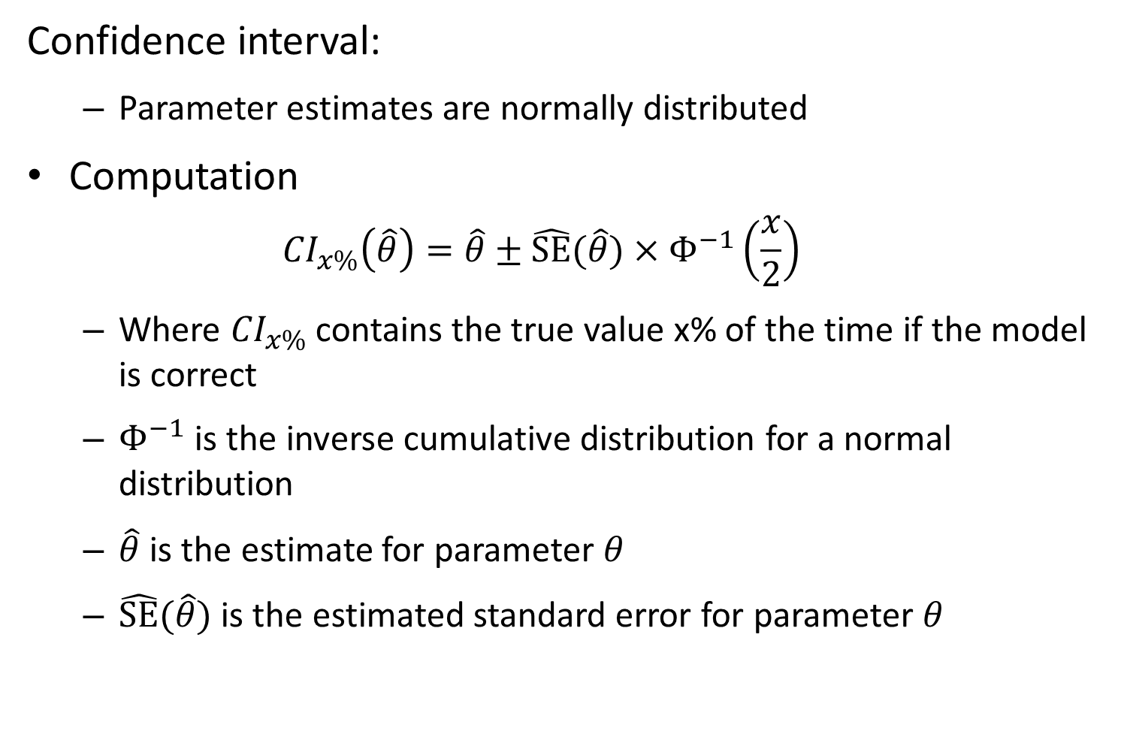
Confidence interval:
Parameter estimates are normally distributed
Computation
$${CI}_{x\%}\left(\hat{θ}\right)=\hat{θ}±\hat{SE}(\hat{θ})×Φ^{−1}\left(\frac{x}{2}\right)$$
Where ${CI}_{x\%}$ contains the true value x% of the time if the model is correct
$Φ^{−1}$ is the inverse cumulative distribution for a normal distribution
$\hat{θ}$ is the estimate for parameter $θ$
$\hat{SE}(\hat{θ})$ is the estimated standard error for parameter $θ$

Slide 40
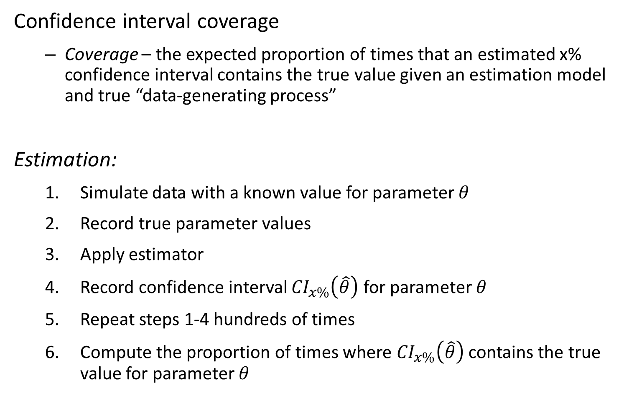
Confidence interval coverage
Coverage – the expected proportion of times that an estimated x% confidence interval contains the true value given an estimation model and true “data-generating process”
Estimation:
Simulate data with a known value for parameter $θ$
Record true parameter values
Apply estimator
Record confidence interval ${CI}_{x\%}\left(\hat{θ}\right)$ for parameter $θ$
Repeat steps 1-4 hundreds of times
Compute the proportion of times where ${CI}_{x\%}\left(\hat{θ}\right)$ contains the true value for parameter $θ$

